Slide 1
Beyond the budget 2021-22: Fiscal outlook and scenarios
Parliamentary Budget Office
www.pbo.gov.au
September 2021

Slide 2
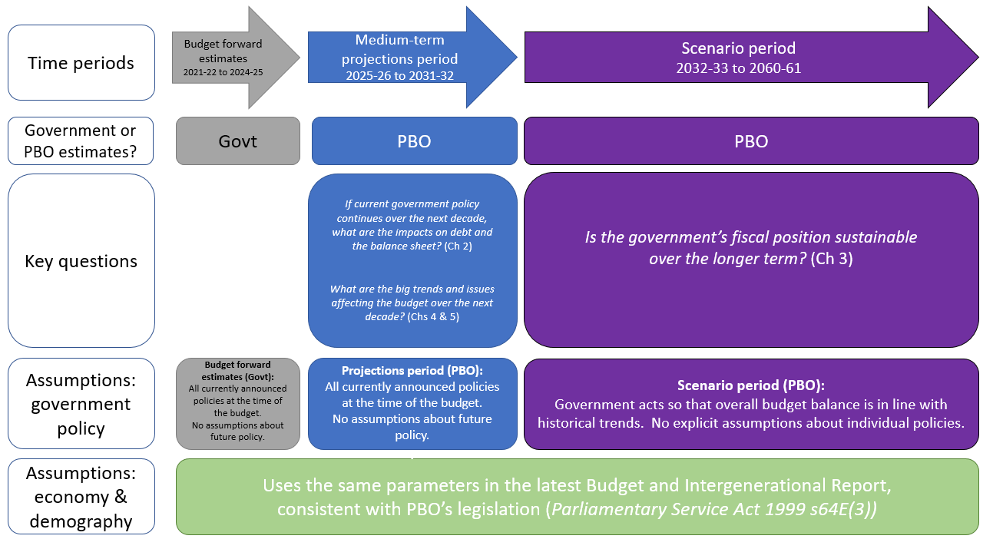
Figure 1-1: Beyond the budget: summary of approach, inputs and assumptions
Source: PBO.

Slide 3
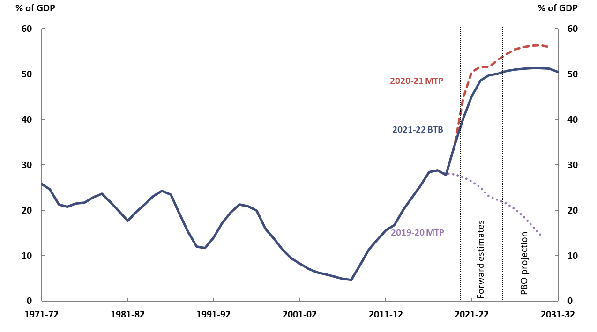
Figure 2-1: Gross debt
Note: ‘MTP’ refers to PBO’s previous medium-term projections reports. ‘BTB’ is short for Beyond the Budget.
Source: 2019-20, 2020-21 and 2021-22 Budget and PBO analysis.

Slide 4
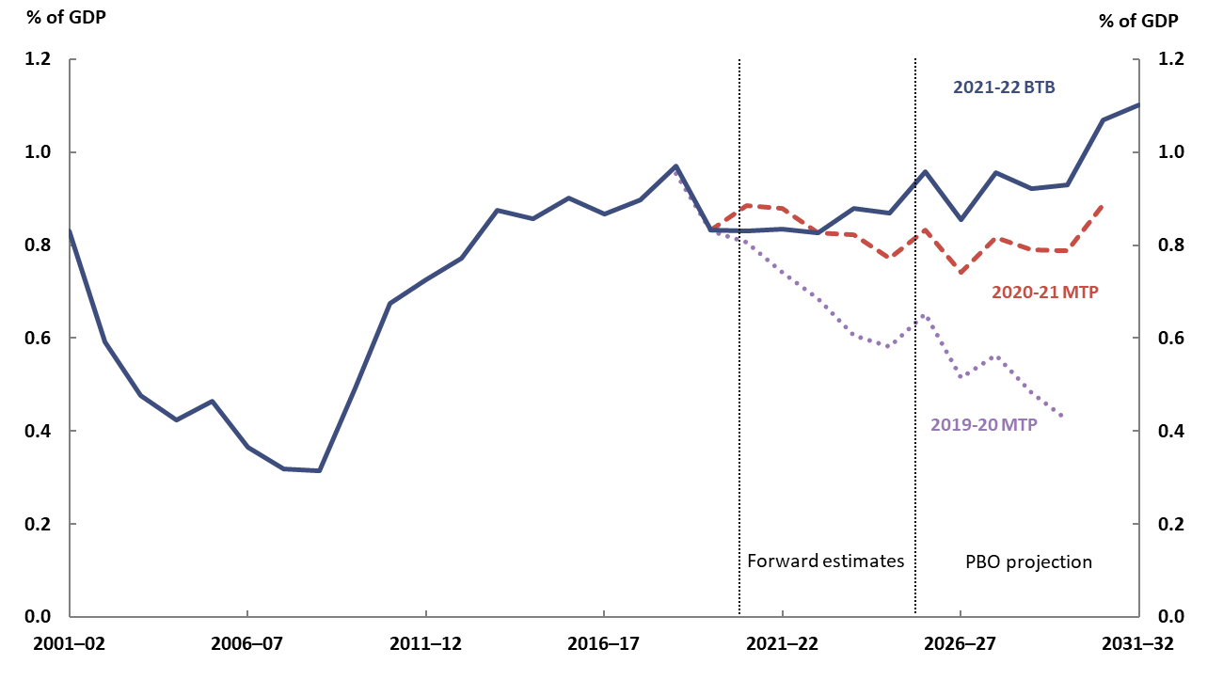
Figure 2-2: Interest payments
Note: Previous medium term projections reports have used a slightly different definition of interest payments. This current approach has been retrospectively projected in this report for comparison. The small volatility in the projections for interest payments reflects the different dates at which various bonds mature and need to be re-financed. In practice, debt issuance would be managed such that this variability would be smaller.
Source: 2019-20, 2020-21, 2021-22 Budget and PBO analysis.

Slide 5
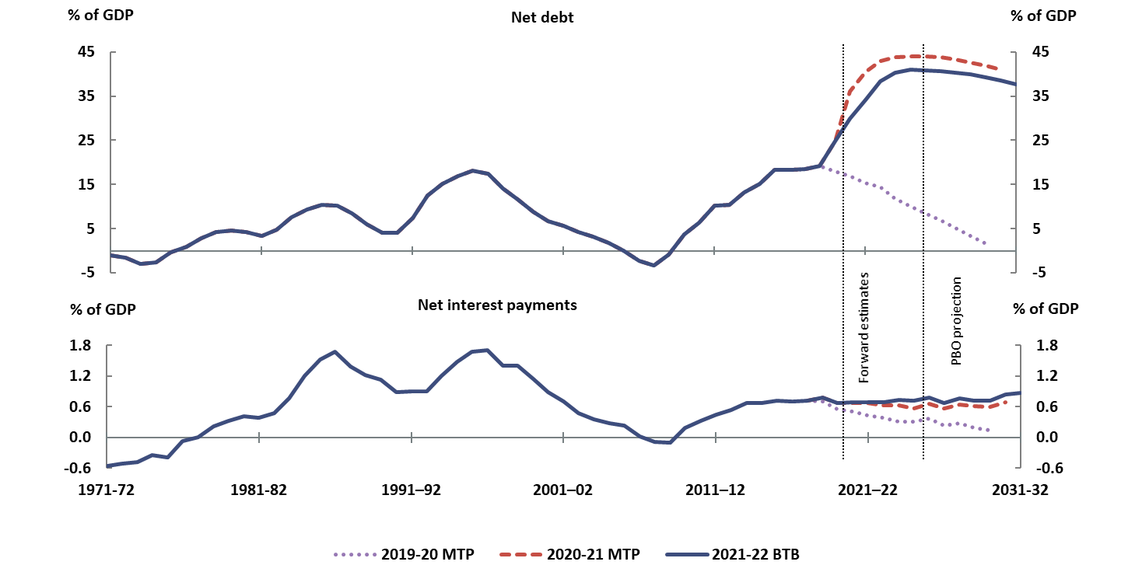
Figure 2-3: Net debt and net interest payments
Note: Net interest payments are equal to total interest payments less interest receipts.
Source: 2019-20, 2020-21 and 2021-22 Budget and PBO analysis.

Slide 6
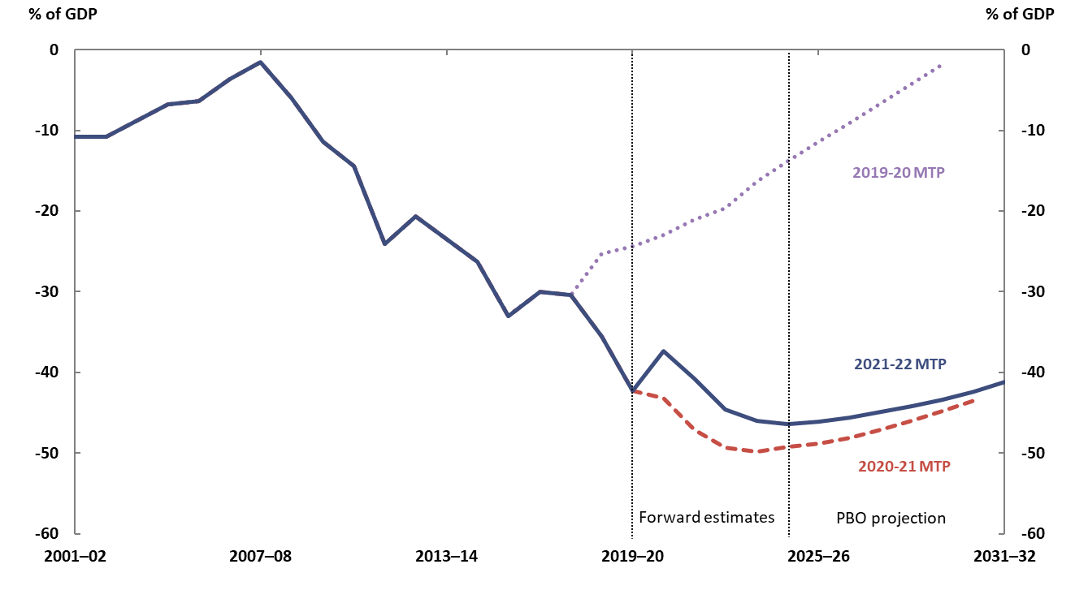
Figure 2-4: Net financial worth
Note: Negative values indicate that relevant liabilities exceed relevant assets, so moving from a larger to a smaller negative number represents an improved financial position.
Source: 2019-20, 2020-21 and 2021-22 Budget and PBO analysis.

Slide 7
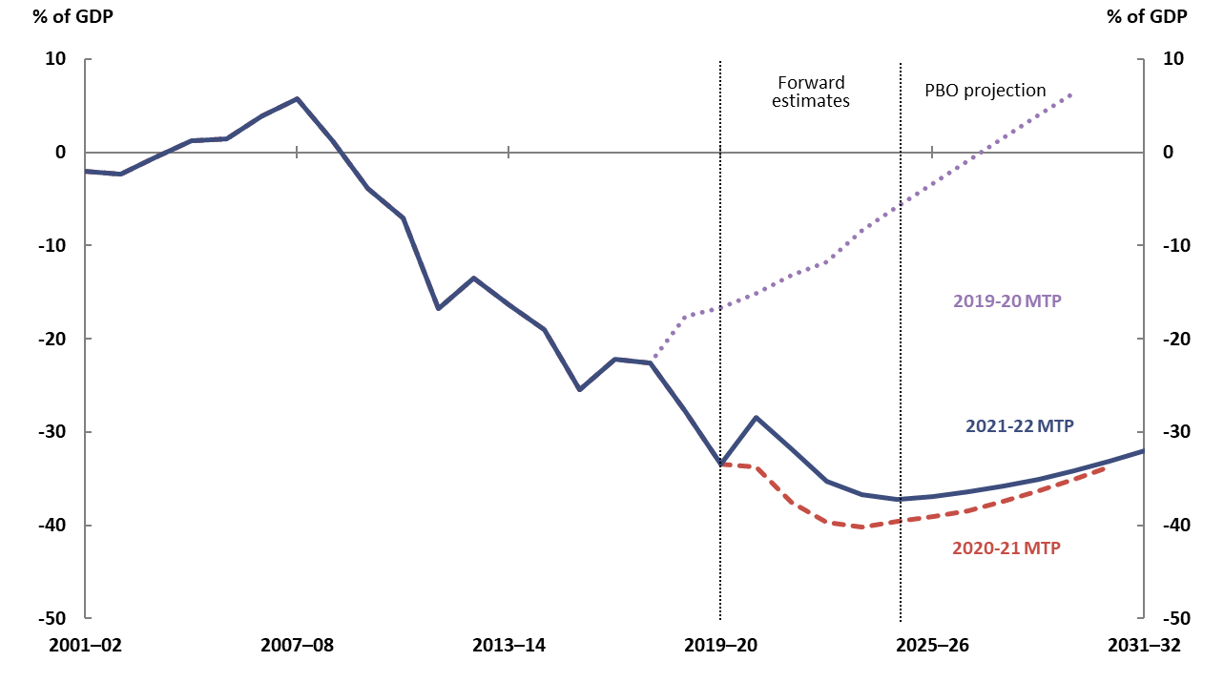
Figure 2-5: Net worth
Note: Negative values indicate that relevant liabilities exceed relevant assets, so moving from a larger to a smaller negative number represents an improved financial position.
Source: 2019-20, 2020-21 and 2021-22 Budget and PBO analysis.

Slide 8
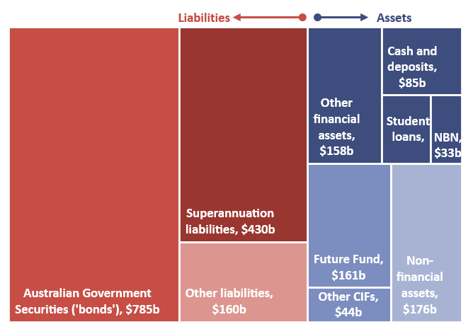
Figure 2-6: Commonwealth Government assets and liabilities as at 30 June 2020
Note: See page 12 of the Beyond the budget main paper.
Source: 2019-20 Final Budget Outcome, Department of Infrastructure, Transport, Regional Development and
Communications 2019 20 Annual Report and PBO analysis.

Slide 9
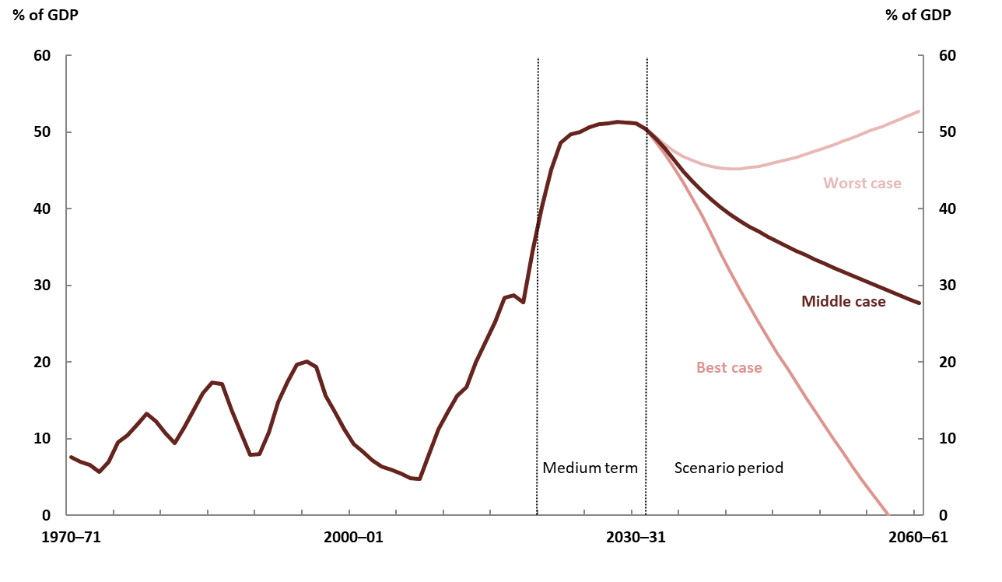
Figure 3-1: Gross debt to GDP stabilises across a broad range of scenarios
Source: 2021-22 Budget and PBO analysis.

Slide 10
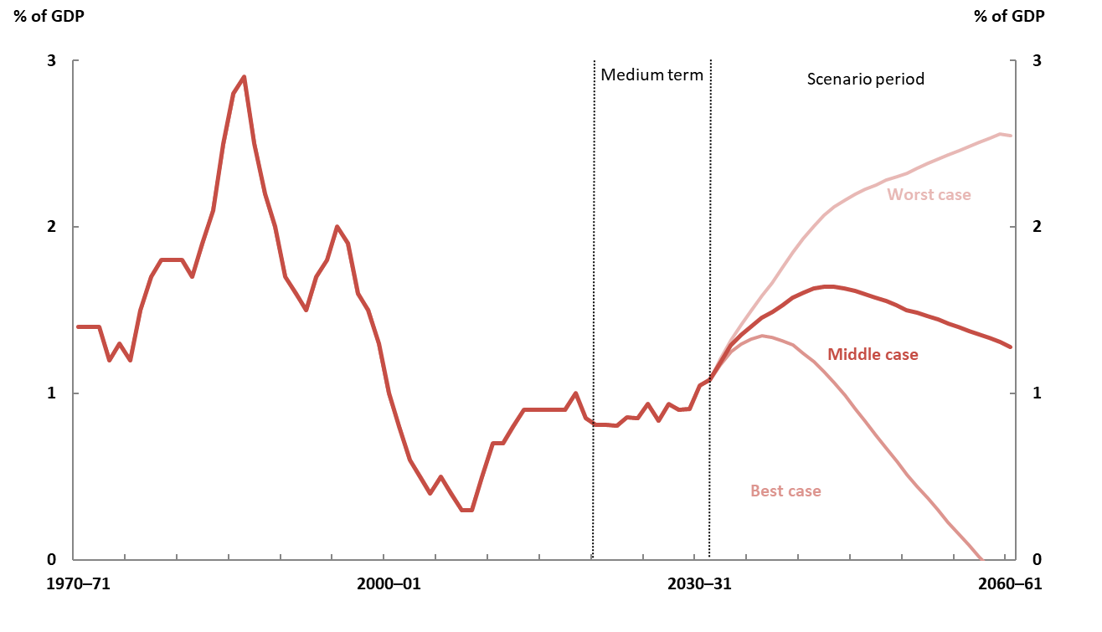
Figure 3-2: Most scenarios result in interest payments comparable to recent experience
Public debt interest
Source: 2021-22 Budget and PBO analysis.

Slide 11
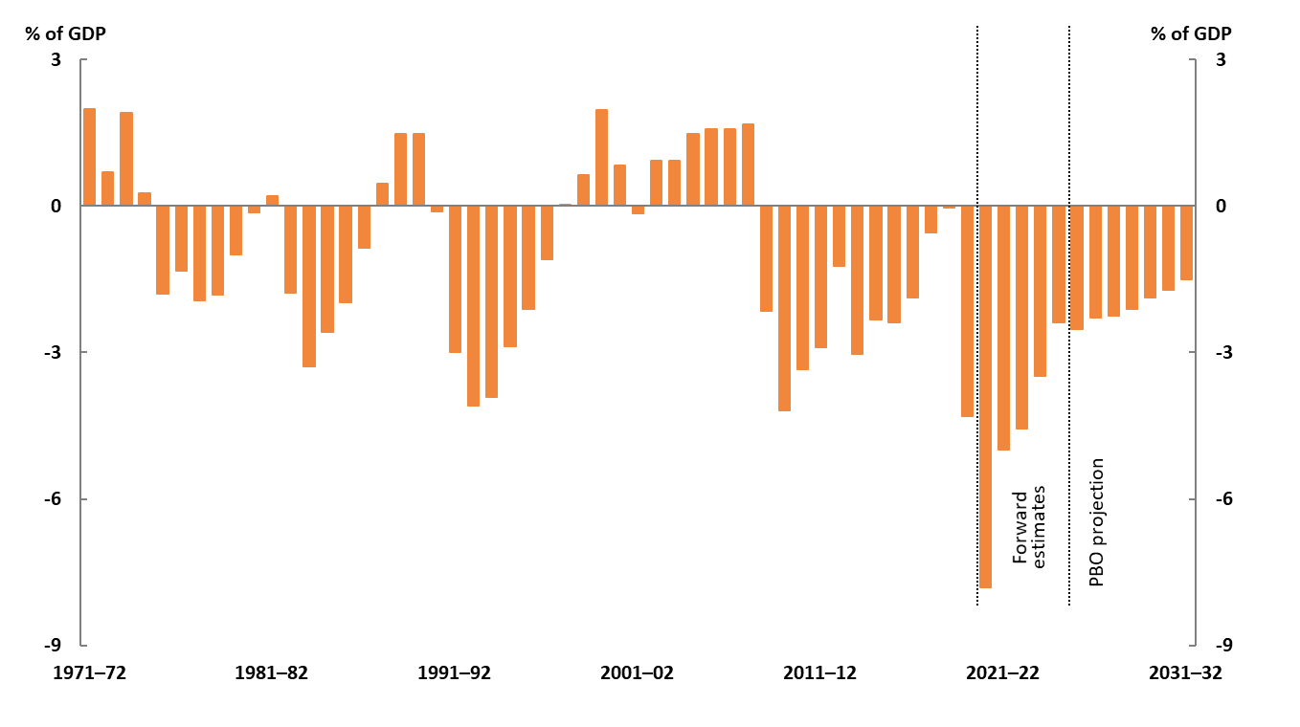
Figure 4-1: Underlying cash balance
Source: 2021-22 Budget and PBO analysis.

Slide 12
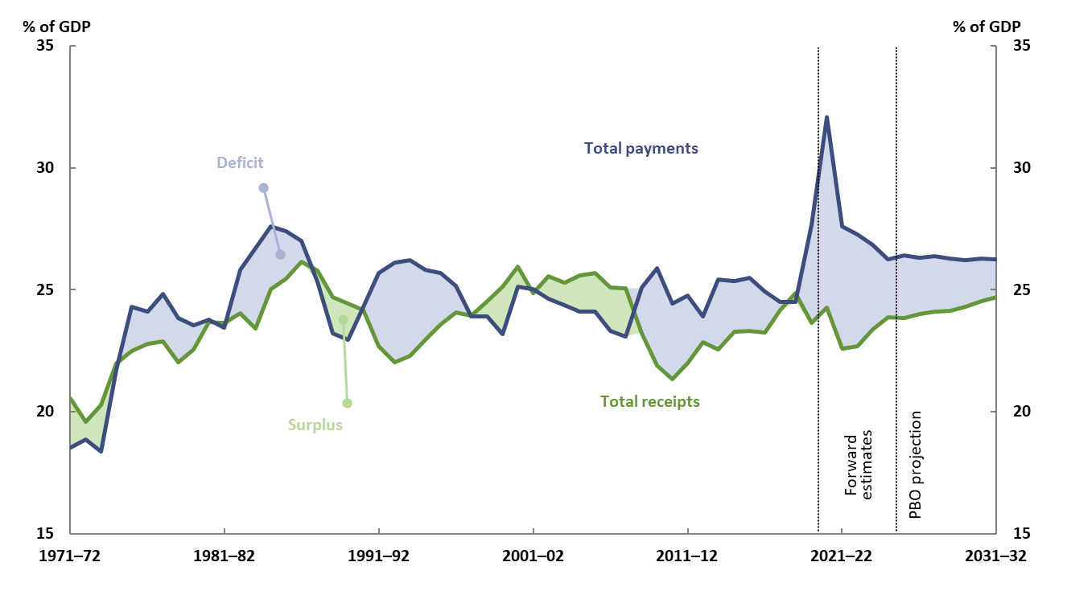
Figure 4-2: Total receipts and payments
Note: The shaded areas broadly correspond to a surplus (green) or deficit (blue) by today’s definition of the underlying cash balance.
Source: 2021-22 Budget and PBO analysis.

Slide 13
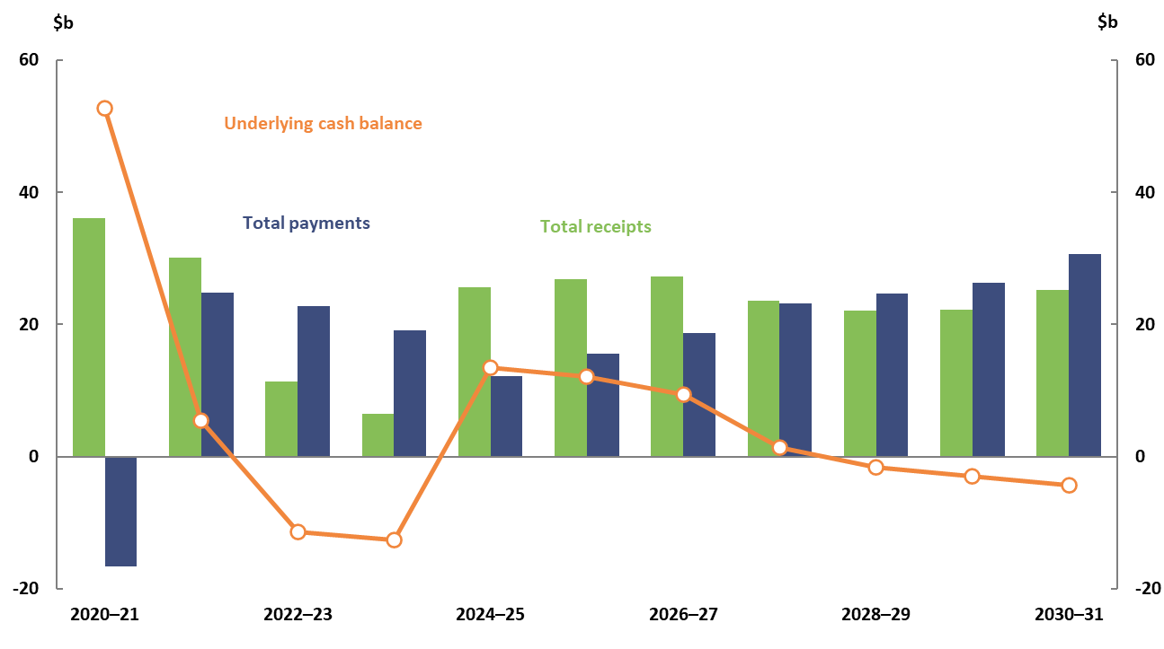
Figure 4-3: Revisions to projections compared to the 2020-21 report
Source: 2020-21 and 2021-22 Budget and PBO analysis.

Slide 14
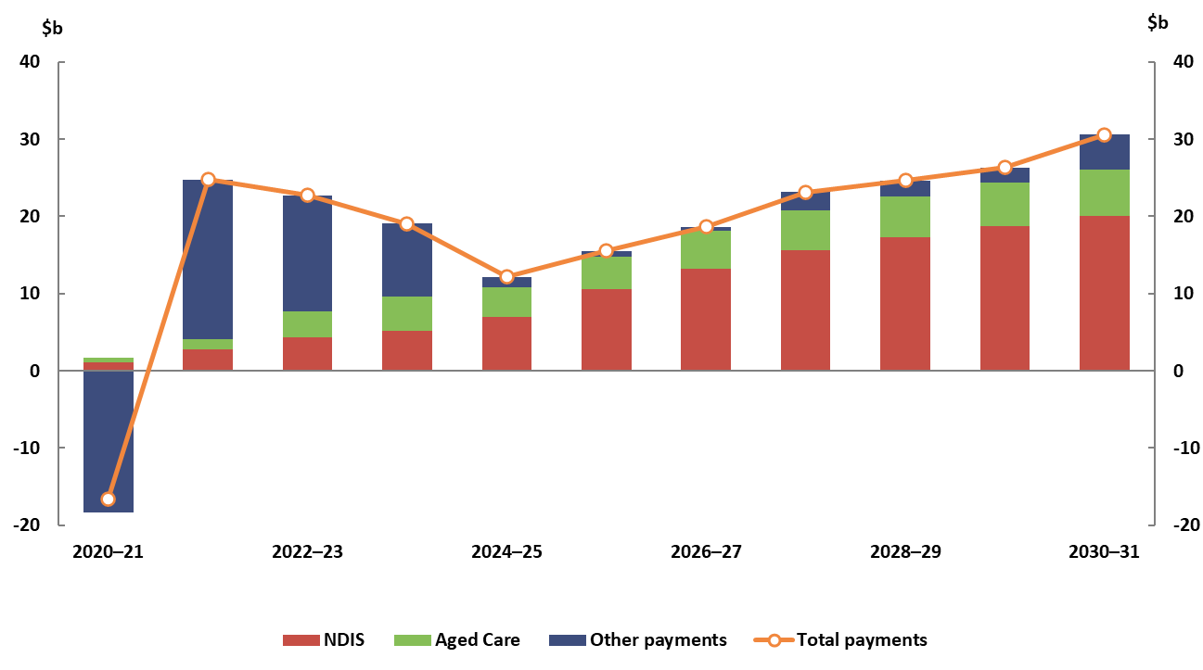
Figure 4-4: Breakdown of revisions in total payments compared to the 2020-21 report
Note: NDIS estimates reflect the PBO’s base NDIS scenario.
Source: 2020-21 and 2021-22 Budget and PBO analysis.

Slide 15
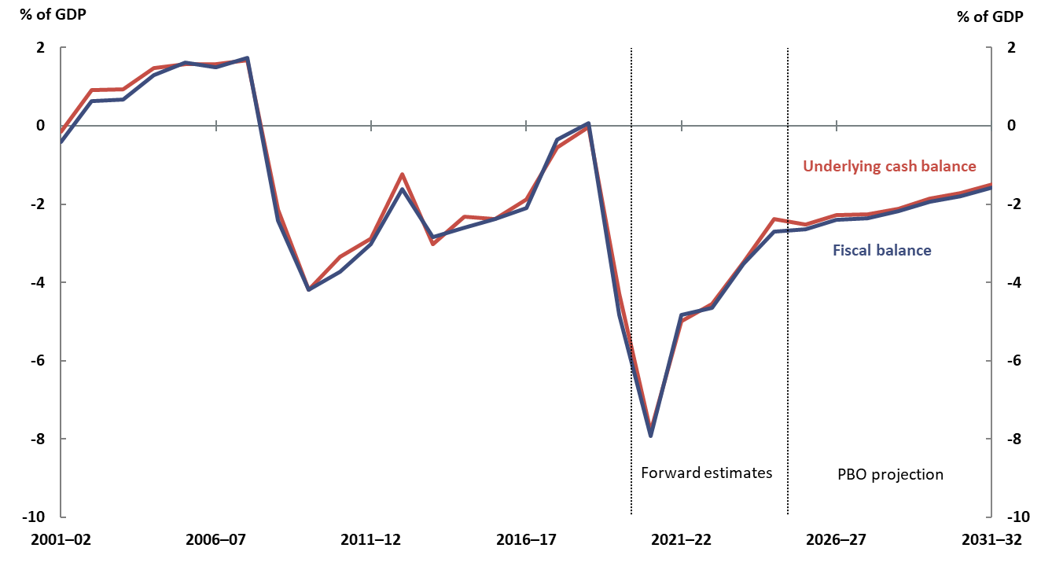
Figure 4-5: Fiscal balance
Source: 2021-22 Budget and PBO analysis.

Slide 16
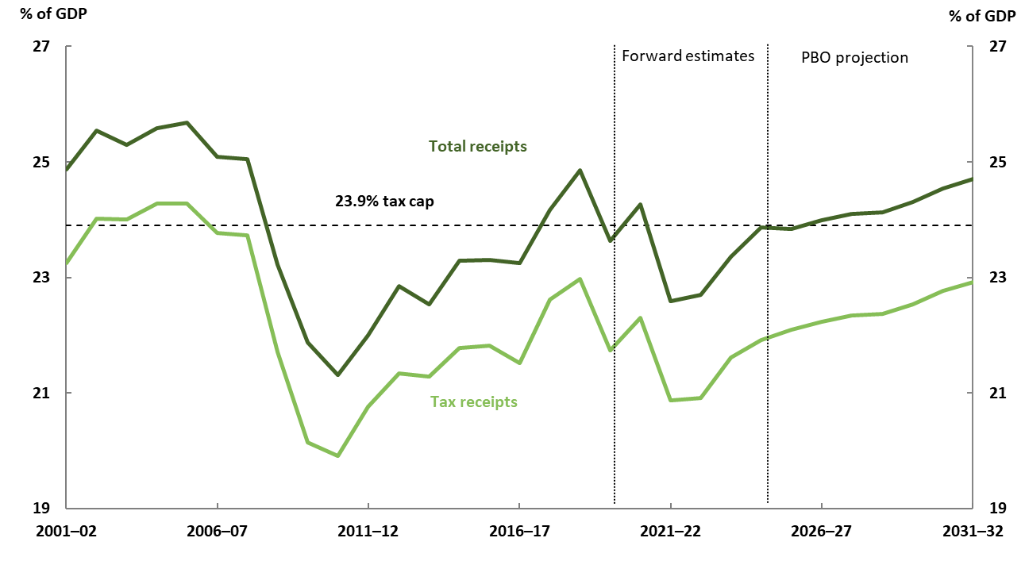
Figure 4-6: Total receipts and tax receipts
Notes: Total receipts includes tax and non-tax receipts. Non-tax receipts include interest and dividend earnings (including Future Fund earnings), NDIS contributions from the states and territories, royalties and the sale of non-financial assets.
Source: 2021-22 Budget and PBO analysis.

Slide 17
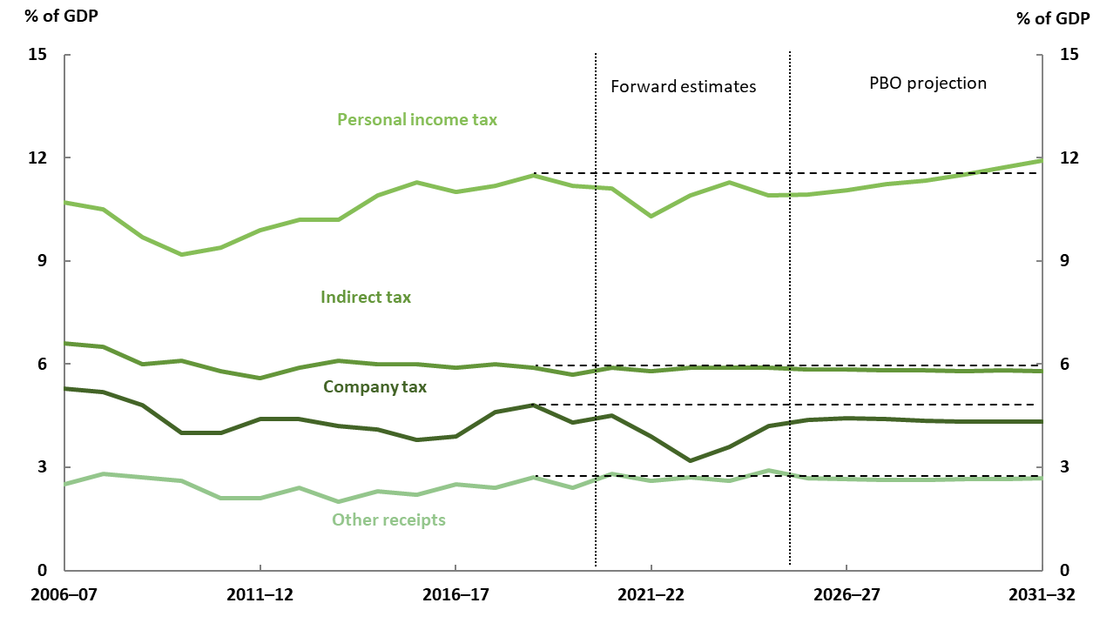
Figure 4-7: Breakdown of receipts
Note: Broadly speaking, an indirect tax is a tax levied on goods and services. Indirect taxes comprise GST, fuel, tobacco and alcohol excise and customs duty, agricultural levies, passenger movement charge, broadcasting license fees and a range of other levies, penalties and charges. All other receipts are grouped together as ‘other receipts’. The dashed horizontal lines show the 2018-19 levels for comparison.
Source: 2021-22 Budget and PBO analysis.

Slide 18
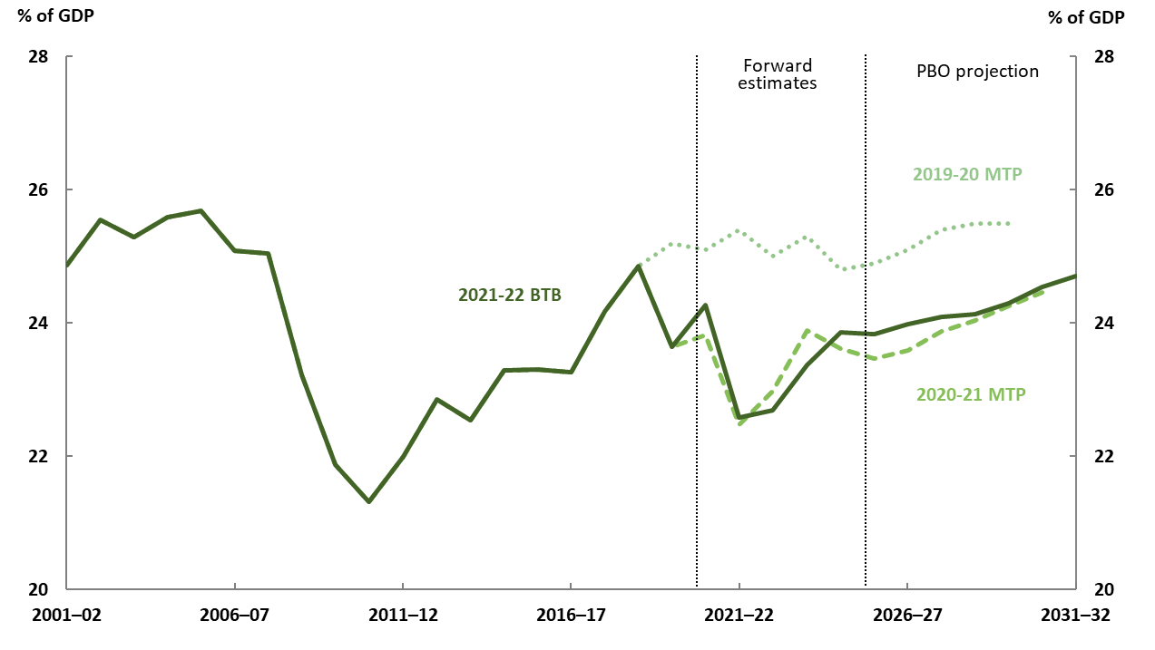
Figure 4-8: Comparison of total receipts
Source: 2019-20, 2020-21 and 2021-22 Budget and PBO analysis.

Slide 19
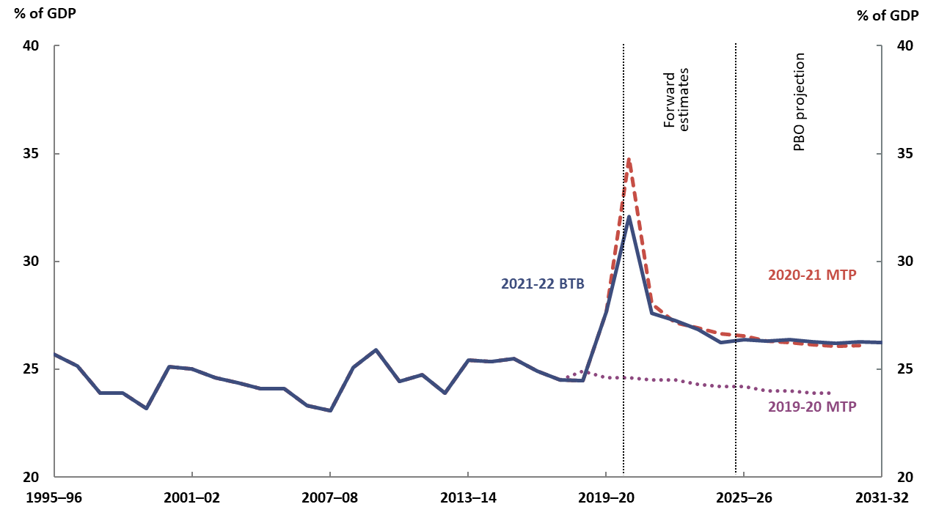
Figure 4-9: Total payments
Source: 2019-20, 2020-21 and 2021-22 Budget and PBO analysis.

Slide 20
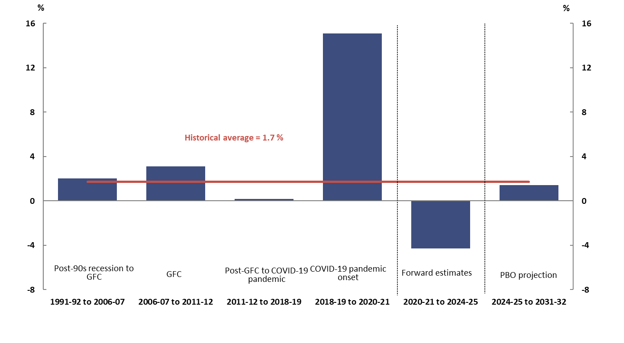
Figure 4-10: Average annual growth in real payments per person
Note: Long run average calculated over 1991-92 to 2018-19. The average including the onset of COVID-19 and associated policy response in 2019-20 and 2020 21 would increase to 2.6 per cent. GFC refers to the global financial crisis.
Source: 2021-22 Budget and PBO analysis.

Slide 21
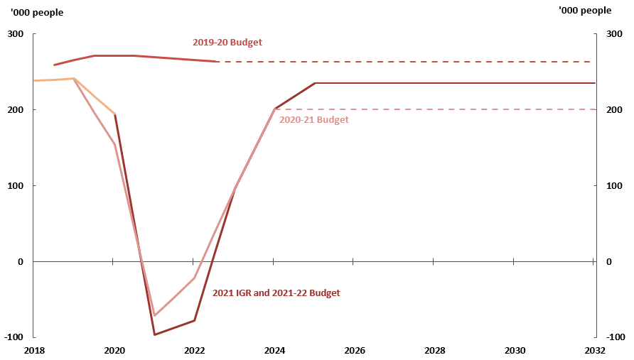
Figure 4-11: Recent net overseas migration projections
Note: The 2019-20 and 2020-21 Budgets do not include medium-term projections for net overseas migration, so the dotted lines represent what these projections would be if net overseas migration were constant from the end of the forward estimates over the long term.
Source: 2019-20, 2020-21 and 2021-22 Budgets, 2021 Intergenerational Report, Australian Bureau of Statistics (ABS) Migration, Australia, 2019-20 (previously cat. no. 3412.0) and PBO analysis.

Slide 22
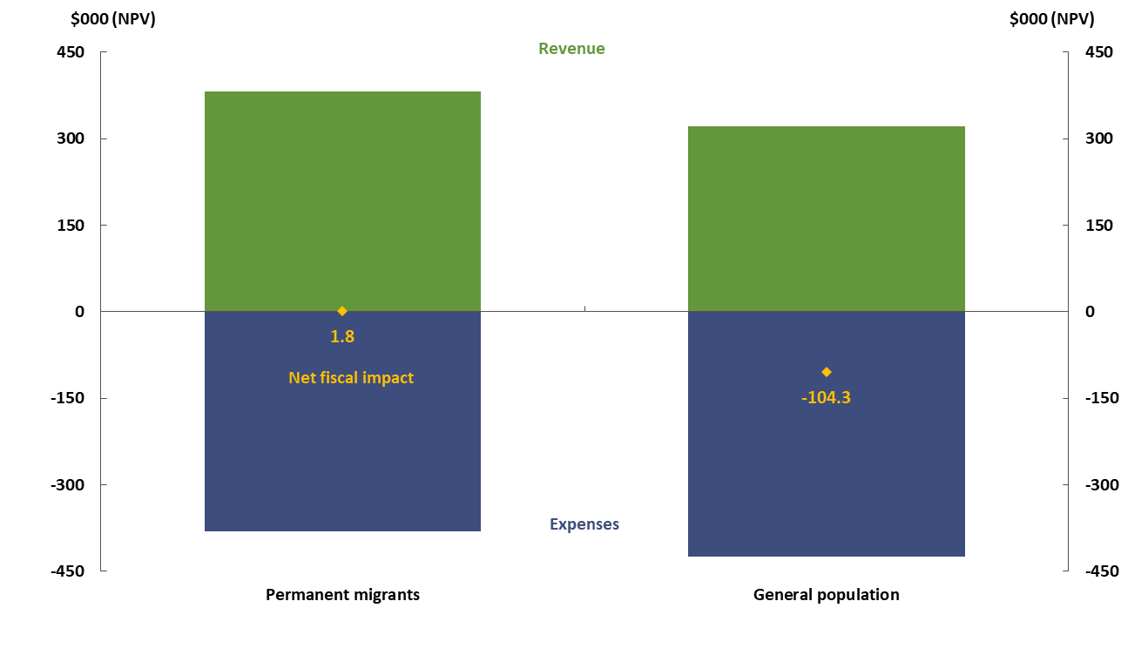
Figure 4-12: Lifetime fiscal impact on the Commonwealth budget per person
Note: See page 30 of the Beyond the budget main paper.
Source: 2019-20, 2020-21 and 2021-22 Budgets, 2021 Intergenerational Report, Australian Bureau of Statistics (ABS) Migration, Australia, 2019-20 (previously cat. no. 3412.0) and PBO analysis.

Slide 23
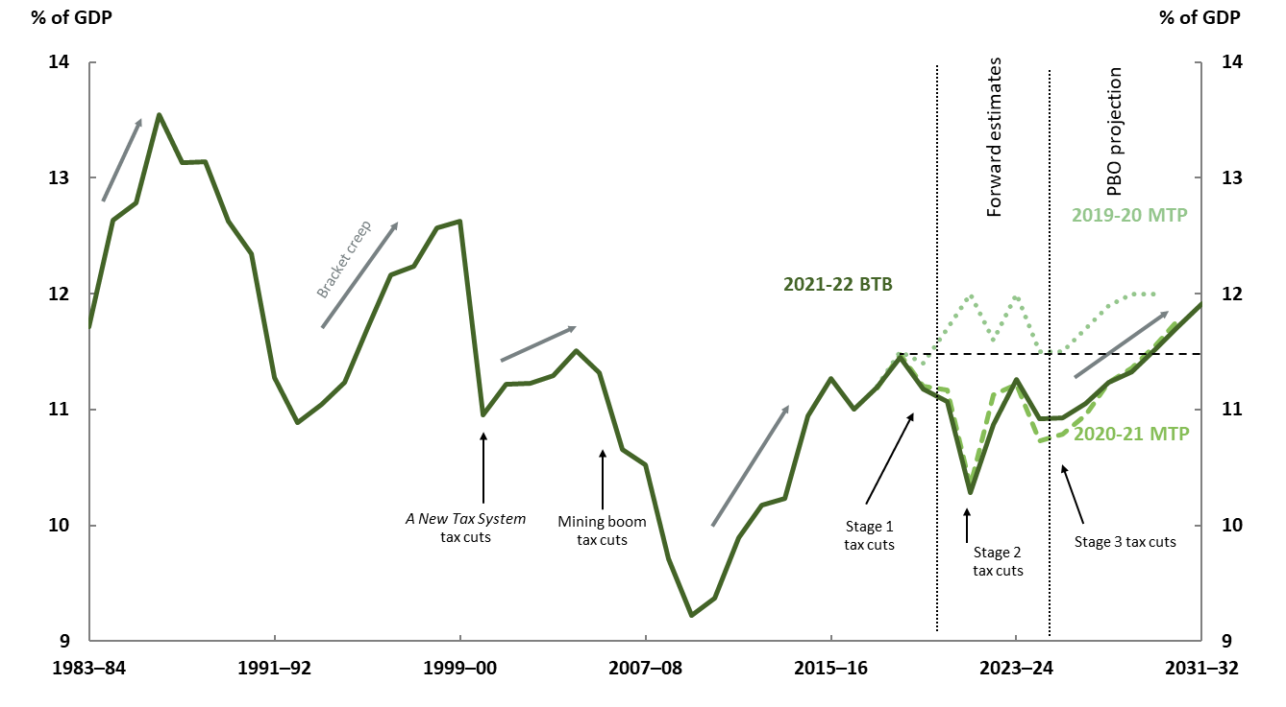
Figure 4-13: Personal income tax
Note: The dashed horizontal line shows the 2018-19 levels for comparison.
Source: 2021-22 Budget and PBO analysis.

Slide 24
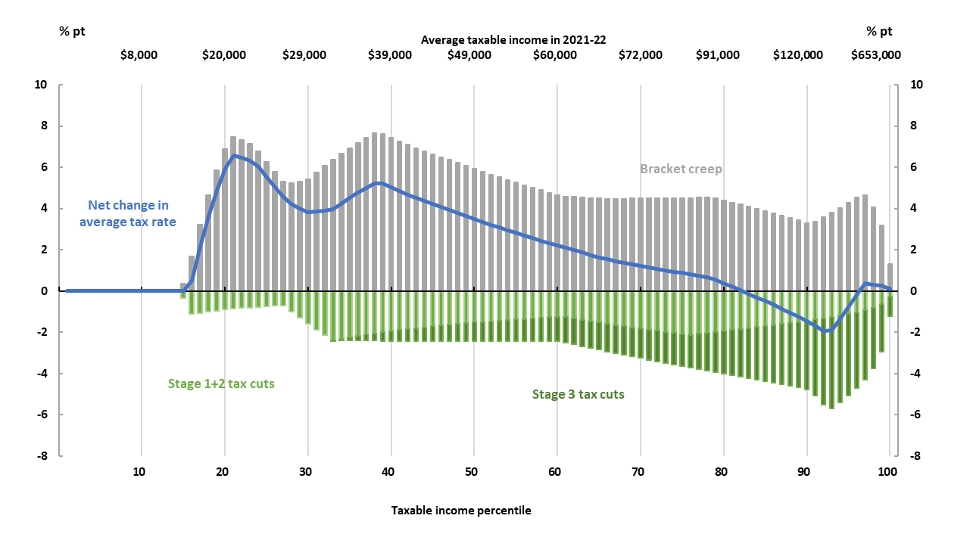
Figure 4-14: Change in average tax rates by income percentile (and related taxable income)
Note: While Stage 1 and 2 of the personal income tax cuts were implemented before 2021-22, they are included here to show the full impact of all three stages of the Personal income tax plan (relative to the tax settings in 2017-18). Eighteen per cent of tax returns have taxable incomes below the tax-free threshold. Taxable income values shown here are the projected average income for the corresponding percentile in 2021-22, rounded to the nearest thousand.
Source: PBO analysis of a de-identified 16 per cent sample of personal income tax filers provided by the Australian Tax Office, projected over the medium term.

Slide 25
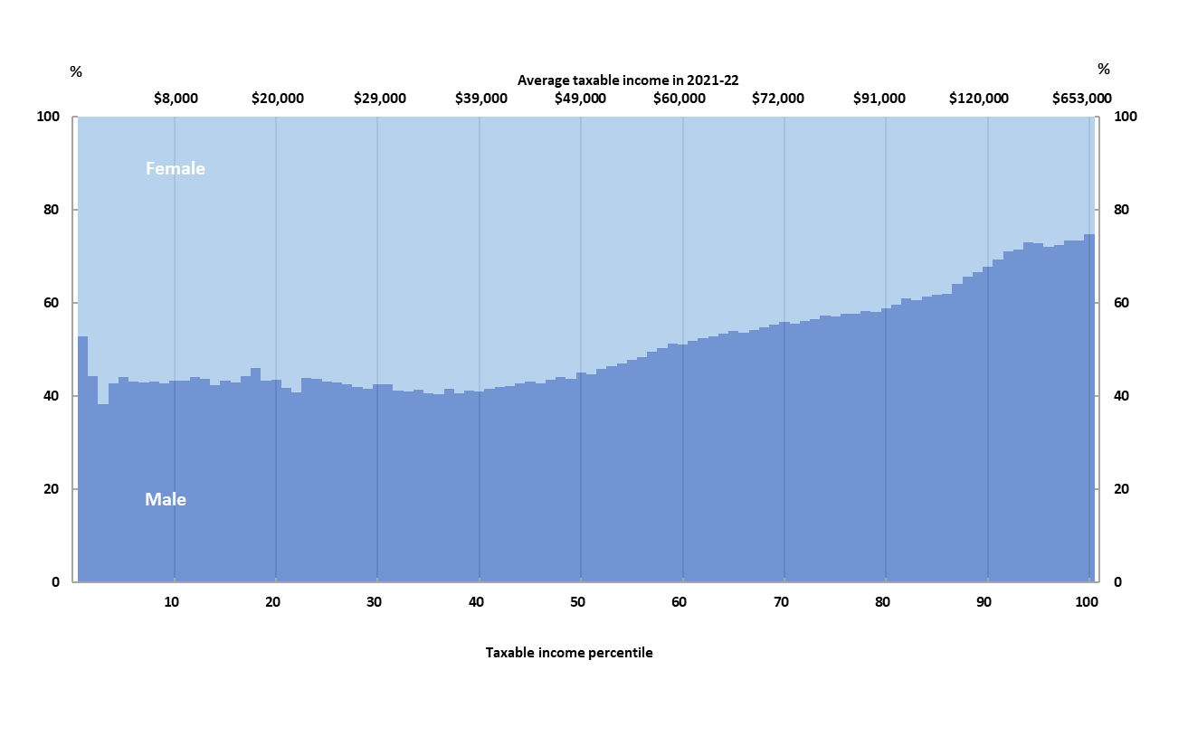
Figure 4-15: Gender distribution of taxable income earners by percentile (and related taxable income)
Note: Average tax rates are calculated as the total tax paid divided by total taxable income for both males and females. The analysis assumes that the average growth rate in income is the same for males and females over the period.
Source: PBO analysis of a de-identified 16 per cent sample of personal income tax filers provided by the Australian Tax Office, projected over the medium term.

Slide 26
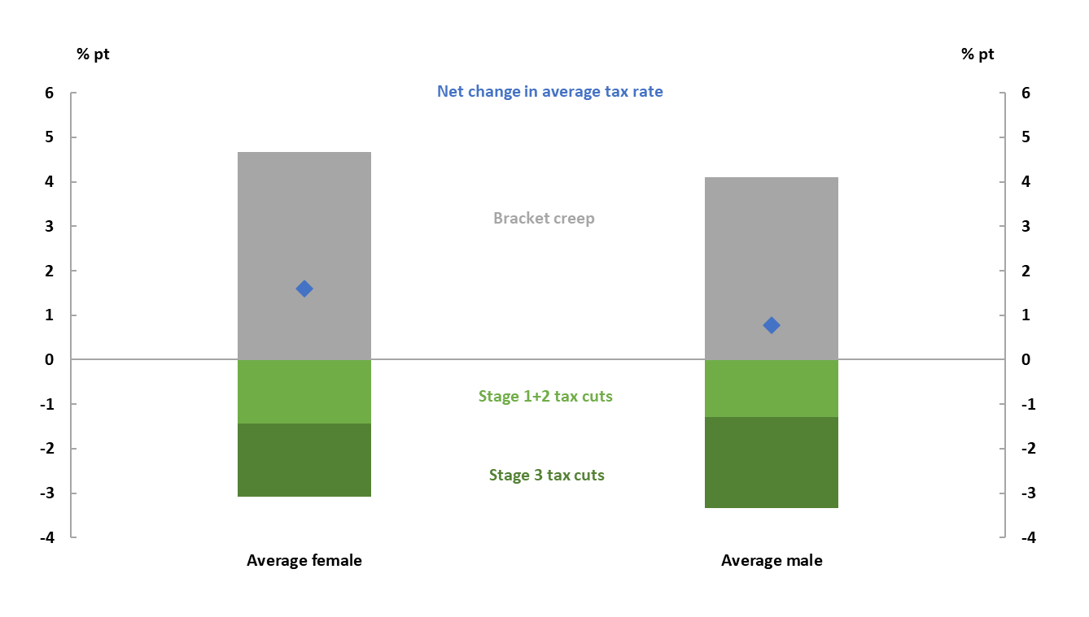
Figure 4-16: Change in average tax rates experienced by the average income earner by gender (Aggregate impact from 2021-22 to 2031-32)
Note: Average tax rates are calculated as the total tax paid divided by total taxable income for both males and females. The analysis assumes that the average growth rate in income is the same for males and females over the period.
Source: PBO analysis of a de-identified 16 per cent sample of personal income tax filers provided by the Australian Tax Office, projected over the medium term.

Slide 27
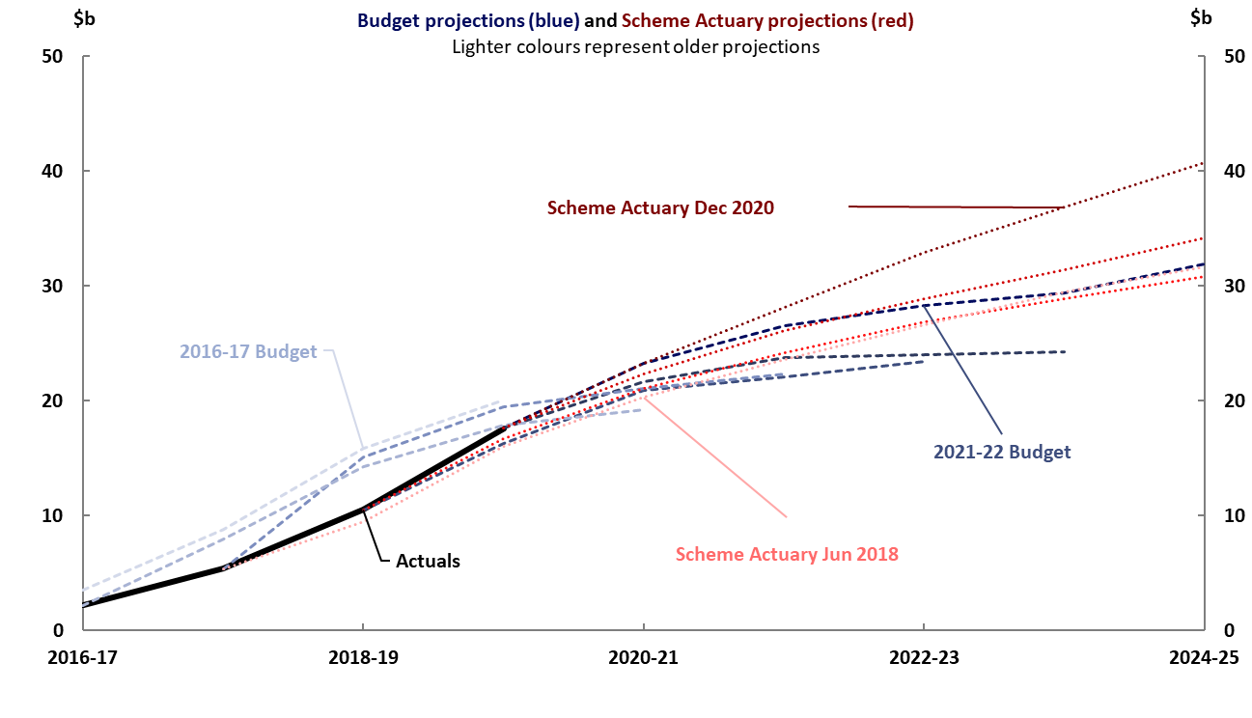
Figure 4-17: Actual and projected NDIS costs
Note: Participant costs from Budget papers are on an accrual basis for consistency with the Scheme Actuary projections. Excludes costs of the National Disability Insurance Agency and NDIS Quality and Safeguards Commission. Scheme Actuary projections are from June 2018, June 2019, June 2020 and December 2020.
Source: NDIS Quarterly Report to disability ministers 30 June 2021 pp. 98-100, 2016-17 to 2021-22 Budgets and PBO analysis.

Slide 28
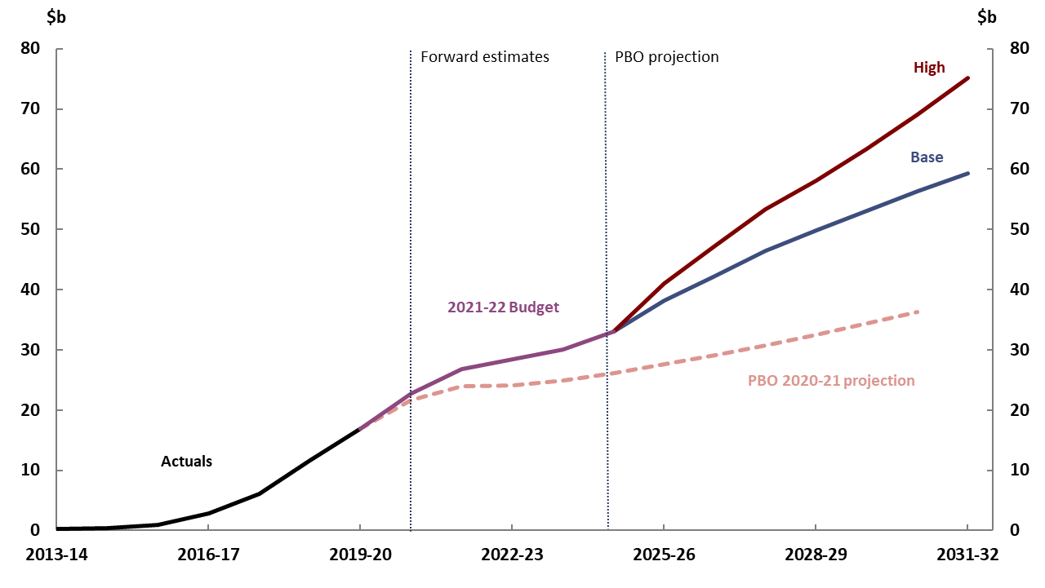
Figure 4-18: Scenarios for NDIS payments
Note: Total projected NDIS payments made by the Commonwealth, comprising payments to participants, and departmental payments of the National Disability Insurance Agency and the NDIS Quality and Safeguards Commission. Includes projected state and territory payments to the Commonwealth for the NDIS.
Source: NDIS Annual Financial Sustainability Report - Interim Update July 2021 (Table 21a), 2021-22 Budget and PBO analysis.

Slide 29
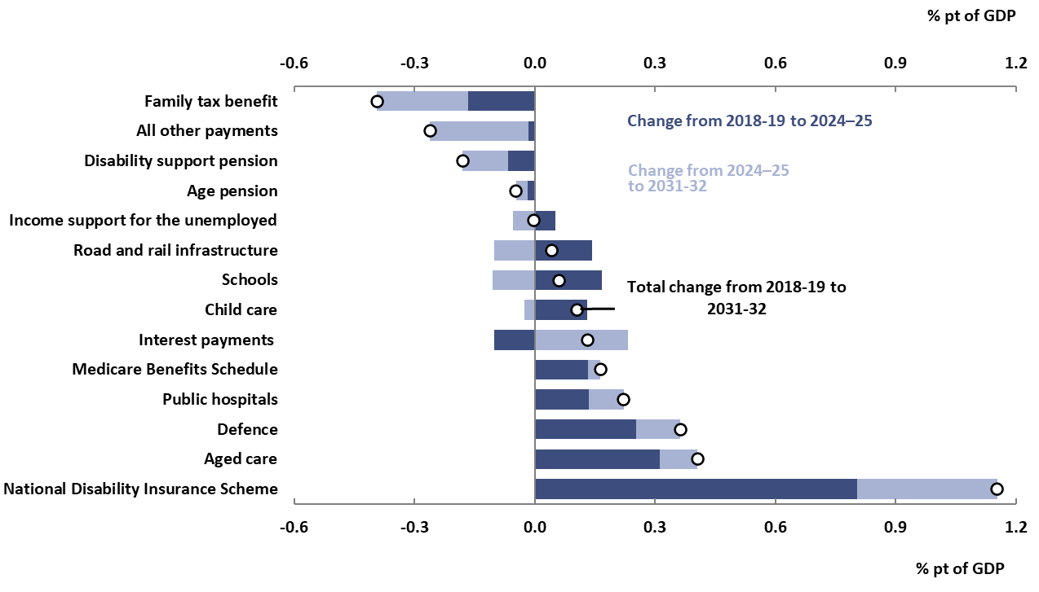
Figure 5-1: Projected change in payments as a share of GDP
Note: ‘All other payments’ includes the total of all payments programs not separately identified in this chart.
Source: 2021-22 Budget and PBO analysis.

Slide 30
Supplementary paper

Slide 31
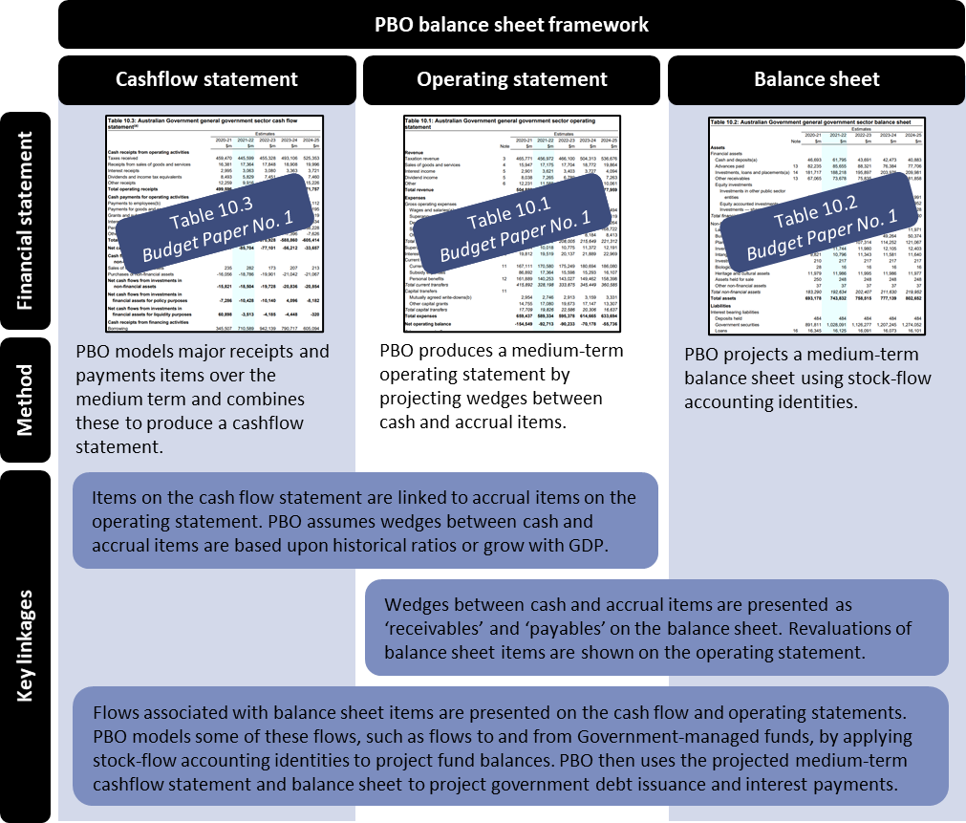
Figure 2-1: PBO balance sheet framework – overview
Source: PBO analysis.

Slide 32
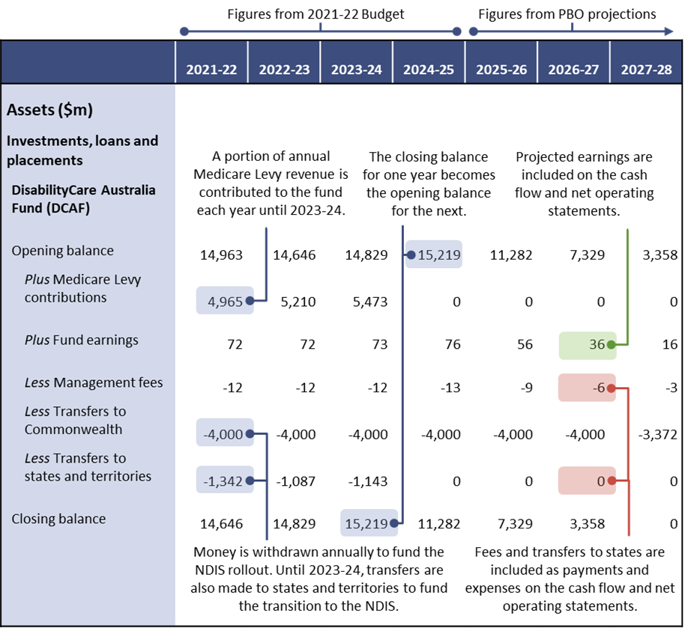
Figure 2-2: PBO balance sheet framework – DisabilityCare Australia Fund (DCAF) stock flow
Source: 2021-22 Department of Finance Portfolio Budget Statement, p. 29 and PBO analysis.

Slide 33
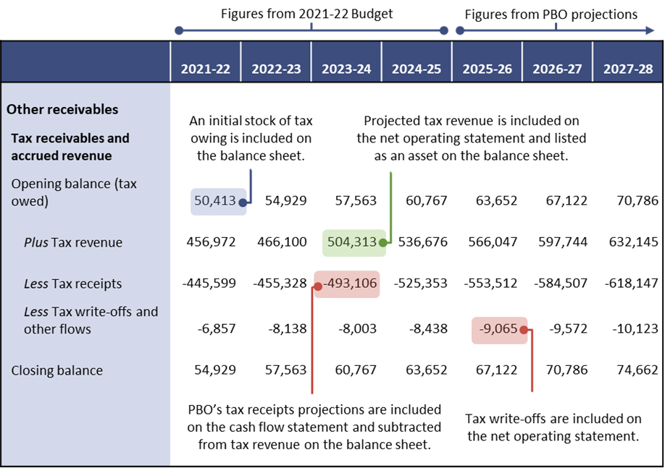
Figure 2-3: PBO balance sheet framework – tax receivables and accrued revenue stock flow
Note: Tax receivables and accrued revenue reflect tax recognised but not yet received. For the purpose of this illustrative example, the item ‘tax write-offs and other flows’ is a residual, which includes changes in receivables from taxes administered by the Department of Home Affairs and other agencies.
Source: 2021-22 Budget, Statement 10, and PBO analysis.

